Slide 1
Health care Institutional Affiliation
Name of Lecturer
Name of student
Date of submission

Slide 2
Shaping the future of health care trends in America
The health care leaders in the USA have a look at how to reshape the industry for better and quality health provision for the residence of the US and patients from foreign countries.
The health leaders are committed to shape future healthcare and come up with a sustainable perfect health community; they are incorporating working with other agencies to ensure they are providing better healthcare.

Slide 3
US perspective on health care trends
The US health care system is moving to focus on the financial structure, which is based on value rather than volume, ensuring the people are healthy and are not in the hospital.
They are working to eradicating the huge charges the patients pay for while in the hospital.
The new trends are to provide universal and quality care to all patients.
In the latest direction of the value-based structure, a patient who goes to see the doctor is seen as an expense and not the source of money

Slide 4
US perspective on health care trends
These trends are to ensure all patients are treated well as members of these new health care system.
This move helps to strengthen patient loyalty and ensure there is an improved health in our nation.
As the organization moves forward this value-based system, there are some trends the US healthcare bodies must put into consideration.

Slide 5
US perspective on health care trends
More focus should be based on a healthy population.
There should be increased virtual care options
There should be movement from illness to wellness to ensure the nation is safe.
Adaptation of new technologies to treat patients who require more attention.
Health plans and procedures should collaborate with health systems to ensure quality health care provision.

Slide 6
2019 World health care sector issues
Creating sustainable financial in heath sector by use of new care delivery structures to improve accessibility and affordability.
Adoption of consuming changing needs, expectation, and demands making use of digital transformation and regulatory innovation measures and ensuring quality provision of health care by retaining top talented health officers.
The introduction of personalized drugs, improved adoption of exponential technologies, and the emergence of competitors in the health sector together with revamped payment.
public provision of funds are affecting the performance of funding structures on the health ecosystem.

Slide 7
There is vigorously stressing on financial management by health care providers.
Impacts the performance operational outcomes-based care that is coming up with innovations to help in addressing spending in the health sector.
Another issue is collaborating with the private health care sector to ensure there are quality access and provision to all people in the nation.

Slide 8
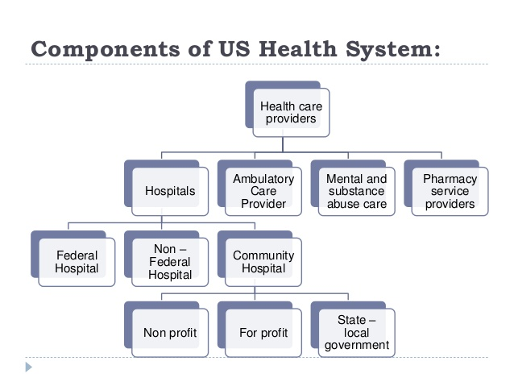
Composition of US health care

Slide 9
Shifting out of volume and going to value will need constructing an outcomes-based financial model and data infrastructure to utilized the use of value-based care, which is an essential method to the growth of much sustainable health systems.
The health care providers are working on the approaches to review the spending in health sectors to ensure the services provided quality and reaching all the people in our nation.
The collaboration between the public sector and the private sector is the critical approach that will ensure both stakeholders adhere to the quality delivery of health services.

Slide 10
You are investing in transformation and digital innovation.
Digital and new use of technologies are helping health sector efforts to adopt new models of sick people centers care to ensure there are quality access and delivery of health care services.
Good health approaches to boost accessibility and affordability, improve health qualities, and reduces the cost of treatment. Intelligence artificial is one of the technologies affecting health care.
These modern technologies are supporting the diagnosis and treatment by speeding up the procedure and ensuring that the treatment is of high quality and accurate and boosting the sick person's experience.

Slide 11
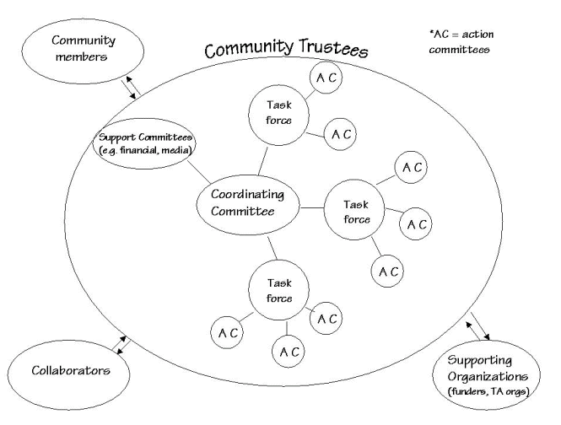

Slide 12
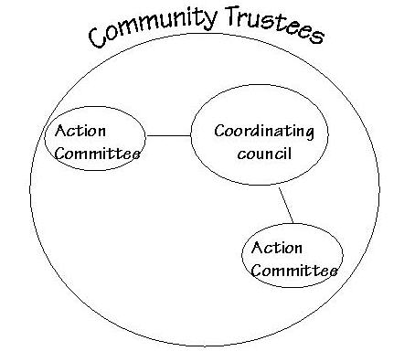

Slide 13
References
Garrison, J. L., Carlson, J. J., Bajaj, P. S., Towse, A., Neumann, P. J., Sullivan, S. D., ... & Dubois, R. W. (2015). Private sector risk-sharing agreements in the United States: trends, barriers, and prospects. The American journal of managed care, 21(9), 632-640.
Singh, D. A. (2015). Essentials of the US health care system. Jones & Bartlett Publishers.
Torchia, M., Calabrò, A., & Morner, M. (2015). Public-private partnerships in the health care sector: a systematic review of the literature. Public Management Review, 17(2), 236-261.

